Slide 1
Insights to Increase AirBnB Revenue

Slide 2
AGENDA
Objective
Background
Key findings
Recommendations
Appendix:
Data sources
Data methodology document

Slide 3
OBJECTIVE
Improve our understanding about the property availability in a year
Understand ways to increase revenue
Get more insights about the new properties to acquire

Slide 4
BACKGROUND
AirBnB has seen a major decline in revenue.
Restrictions are lifting and people have started to travel more
Measures needs to be taken to increase the revenue

Slide 5
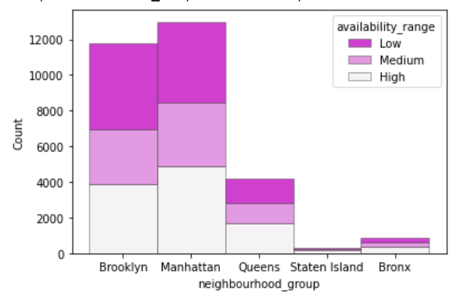
KEY FINDING - 1
Properties availability during the year is an issue

Slide 6
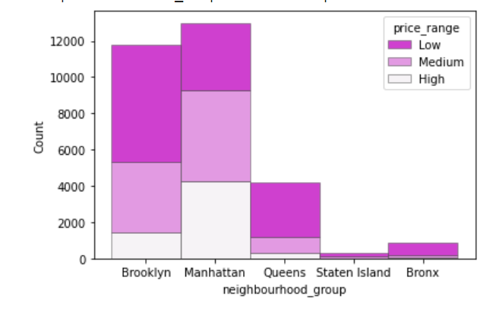
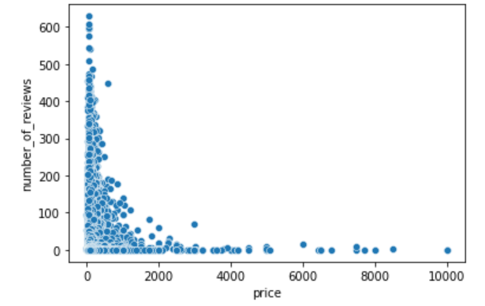
KEY FINDING - 2
High Price of the properties is one of the cause of low revenue – 20% of the properties have per night price as 200$ or more. There is low demand for high price properties

Slide 7
KEY FINDING - 3
Less number of Low/Medium Price Properties in certain areas :

Slide 8
RECOMMENDATIONS
Only 36% of the properties are in High availability range, rest are in Medium or Low availability range. Availability range of the Medium and Low properties to be increased.
Lower down the price range to a previous bracket for e.g. from High to Medium or from medium to low
Properties of hosts like Mike, Alex, Nissim, Lior, Saddatu etc to be acquired more which has Low price range, 365 days availability and renting entire home and in the areas like Staten Island, Bronx and Queens which has less number properties in comparison to Manhattan and Brooklyn

Slide 9
APPENDIX - DATA SOURCES:
Here is a snapshot of our data dictionary.
Categorical Variables
- Room_type
- Neighbourhood_group
- Neighbourhood
Continuous Variables
- Price
- Minimum_nights
- Number_of_reviews
- Reviews_per_month
- Calculated_host_listings_count
- Availability_365
Location Variables
- Latitude
- Longitude
Time Variable
- Last_review
Notes:
Objective

Slide 10
APPENDIX - DATA METHODOLOGY
We conducted a thorough analysis of the home AirBnB data. The process included:
Cleaning the data set
Analyzing the data set
Visualizing the data with the help of available tools
Notes:
Objective

